Slide 1
RULES OF INFERENCE FOR QUANTIFIED STATEMENTS
Lecture # 17

Slide 2
INTRODUCTION
We have discussed rules of inference for propositions.
We will now describe some important rules of inference for statements involving quantifiers, which are given below:
Universal Instantiation
Universal Generalization
Existential Instantiation
Existential Generalization

Slide 3
UNIVERSAL INSTANTIATION
Assume that we know that ∀x P(x) is true:
Then we can conclude that P(c) is true
Here c stands for some specific constant from the domain.
This is called “universal instantiation”
Given the premise ∀x P(x).
Example:
We have a statement “All woman are wise.”
We can conclude that “Lisa is wise”
Where Lisa is member of the domain.

Slide 4
UNIVERSAL GENERALIZATION
Assume that we know that P(c) is true for any value of c
Then we can conclude that ∀x P(x) is true.
This is called “universal generalization”

Slide 5
EXISTENTIAL INSTANTIATION
Assume that we know that ∃x P(x) is true
Then we can conclude that P(c) is true for some value of c
Here c stands for some specific constant from the domain.
This is called “existential instantiation”
Given the premise ∃x P(x).

Slide 6
EXISTENTIAL GENERALIZATION
Assume we know that P(c) is true for some value of c
Then we can conclude that ∃x P(x) is true
This is called “existential generalization”

Slide 7
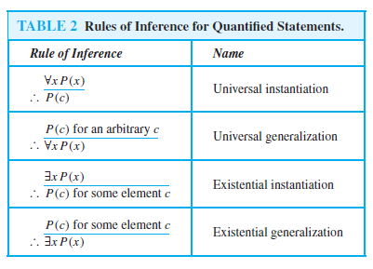

Slide 8
EXAMPLE
Show that the premises:
“Everyone in this discrete mathematics class has taken a
course in computer science” and
“Ramdeen is a student in this class” imply the
conclusion “Ramdeen has taken a course in computer
science.”
Solution:
D(x) = x is in discrete mathematics class.
C(x) = x has taken a course in computer science.

Slide 9
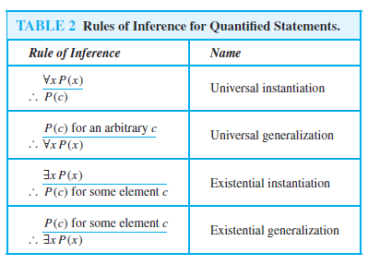
Then the premises are:
∀x (D(x) → C(x))
D(Ramdeen)
C(Ramdeen)
The following steps can be used
to establish conclusion:
1. ∀x (D(x) → C(x)) Premise
2. D(Ramdeen) → C(Ramdeen) Universal
Instantiation
3. D(Ramdeen) Premise
4. C(Ramdeen) Modus Ponens

Slide 10
EXAMPLE
Show that the premises:
“A student in this class has not read the book.” and “Everyone in this class passed the first exam” imply the conclusion “Someone who passed the first exam has not read the book.”
Solution:
C(x) = x is in this class.
B(x) = x has read the book.
P(x) = x passed the first exam.

Slide 11
Then the premises are:
∃ x (C(x) ∧ ¬B(x))
∀x (C(x) → P(x))
∃ x (P(x) ∧ ¬B(x))
The following steps can be used
to establish conclusion:
1. ∃ x (C(x) ∧ ¬B(x)) Premise
2. C(a) ∧ ¬B(a) Existential Instantiation
3. C(a) Simplification
4. ∀x (C(x) → P(x)) Premise
5. C(a) → P(a) Universal Instantiation
6. P(a) Modus Ponens
7. ¬B(a) ∧ C(a) Commutative on (2)
8. ¬B(a) Simplification
9. P(a) ∧ ¬B(a) Conjunction on (6) & (8)
10. ∃ x (P(x) ∧ ¬B(x)) Existential Generalization

Slide 12
COMBINING RULES OF INFERENCE FOR PROPOSITIONS & QUANTIFIED STATEMENTS
A rule of inference for quantified statements, and modus ponens, a rule of inference for propositional logic.
We will often need to use this combination of rules of inference. Because universal instantiation and modus ponens are used so often together.
This combination of rules is sometimes called universal modus ponens.

Slide 13
UNIVERSAL MODUS PONENS
This rule tells us that if ∀x (P(x) → Q(x)) is true, and if P(a) is true for a particular element a in the domain of the universal quantifier, then Q(a) must also be true.
To see this, note that by universal instantiation
P(a) → Q(a) is true.
∀x (P(x) → Q(x))
P(a), where a is a particular element in the domain.
Q(a)

Slide 14
NOTE
Universal modus ponens is commonly used in mathematical arguments.

Slide 15
EXAMPLE
Assume that:
“For all positive integers n, if n is greater than 4, then n² is less then 2^{n}” is true.
Use universal modus ponens to show that 100² < 2¹⁰⁰.
Solution:
Let
P(n) = n > 4
Q(n) = n² < 2^{n} .
The statement can be represented by ∀n(P(n) → Q(n)) Domain = all positive integers

Slide 16
We are assuming that ∀n (P(n) → Q(n)) is true.
P(100) is true. Because 100 > 4.
It follows by universal modus ponens that Q(100) is true, namely 100² < 2¹⁰⁰ .

Slide 17
UNIVERSAL MODUS TOLLENS
Universal modus tollens combines universal instantiation and modus tollens and can be expressed in the following way:
∀x (P(x) → Q(x))
¬Q(a), where a is a particular element in the domain.
¬P(a)

Slide 18
EXERCISE
Use rules of inference to show that if
∀x (P(x) → (Q(x) ∧ S(x))) and
∀x (P(x) ∧ R(x))) are true
then ∀x (R(x) ∧ S(x)) is true
Solution:

Slide 19
The following steps can be used to
establish conclusion:
01. ∀x (P(x) ∧ R(x))) Premise
02. P(a) ∧ R(a) Universal Instantiation
03. P(a) Simplification
04. ∀x (P(x) → (Q(x) ∧ S(x))) Premise
05. Q(a) ∧ S(a) Universal modus ponens
06. S(a) ∧ Q(a) Commutative
07. S(a) Simplification
08. R(a) ∧ P(a) Commutative on (2)
09. R(a) Simplification
10. R(a) ∧ S(a) Conjunction (9) & (7)
11. ∀x (R(x) ∧ S(x)) Universal generalization

Slide 20
EXAMPLE
Use rules of inference to show that if
∀x (P(x) ∨ Q(x)),
∀x (¬Q(x) ∨ S(x)),
∀x (R(x) → ¬S(x)) and
∃x ¬P(x) are true
then
∃x ¬R(x) is true

Slide 22
∀x (P(x) ∨ Q(x)), ∀x (¬Q(x) ∨ S(x)), ∀x (R(x) → ¬S(x)) and ∃x ¬P(x) are true then ∃x ¬R(x) is true
The following steps can be used to
establish conclusion:
01. ∃x ¬P(x) Premise
02. ¬P(c) Existential Instantiation
03. ∀x (P(x) ∨ Q(x)) Premise
04. P(c) ∨ Q(c) Universal Instantiation
05. Q(c) Disjunctive syllogism
06. ∀x (¬Q(x) ∨ S(x)) Premise
07. ¬Q(c) ∨ S(c) Universal Instantiation
08. S(c) Disjunctive syllogism
09. ∀x (R(x) → ¬S(x)) Premise
10. R(c) → ¬S(c) Universal Instantiation
11. ¬R(c) Modus Tollens
12. ∃x ¬R(x) Existential Generalization
Notes:
∀x (P(x) ∨ Q(x)), ∀x (¬Q(x) ∨ S(x)), ∀x (R(x) → ¬S(x)) and ∃x ¬P(x) are true then ∃x ¬R(x) is true

